Slide 1
Welcome
In The
World
Of
Success

Slide 2
No one has a power to change
Their past But
Every one is having a great Power
To change their FUTURE
The Power is
Dreams

Slide 3
OUR INTRODUCTION
SS INNOVEGIC EDGE PVT LTD
(A fast growing company)
This Company is working on five wings with the colabration of Atomy Global EV & H.H.L Foundation
1. Cultivation ( Provide cultivation of Meditational Plants to marginal farmers for improvement financial condition)
2. Health ( Provide low cost better treatment to marginal people).
3. Education ( Free classes and scholarship to poor schooling children ).
4. Entrepreneurship ( Provide better business opportunity to establish own business).
5. Employments ( Here is an opportunity to join with us as Employee / Volunteer).

Slide 4
In this Scenario every one is searching for An Honest, Smart, Realistic & Legal Opportunity to Enjoy An Extraordinary Lifestyle……!!
SS INNOVEGIC EDGE PVT LTD
Presents
Life Changing Opportunity For Better Lifestyle
To Become A Part Of Nationwide Business Campaign Join Us

Slide 5
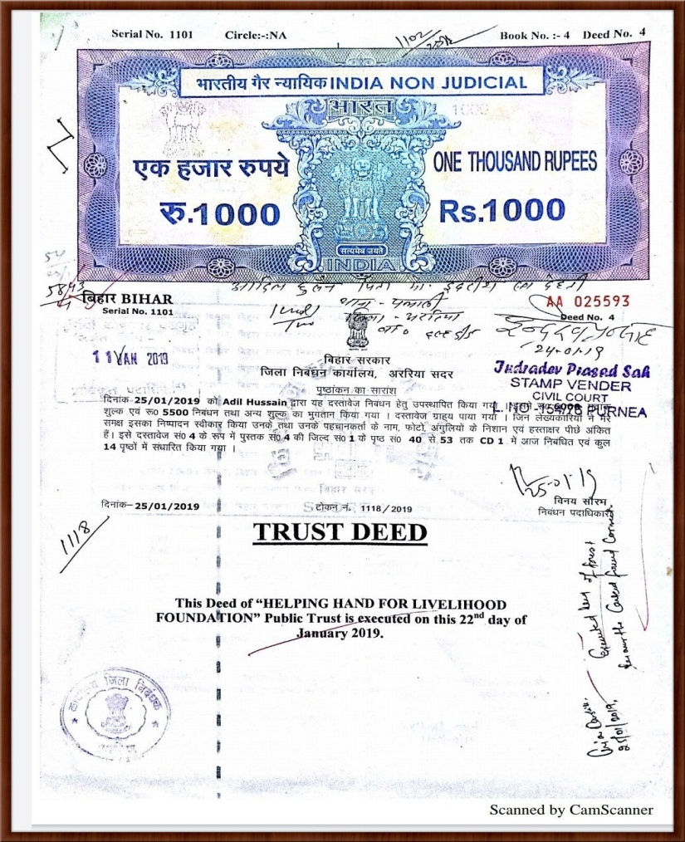
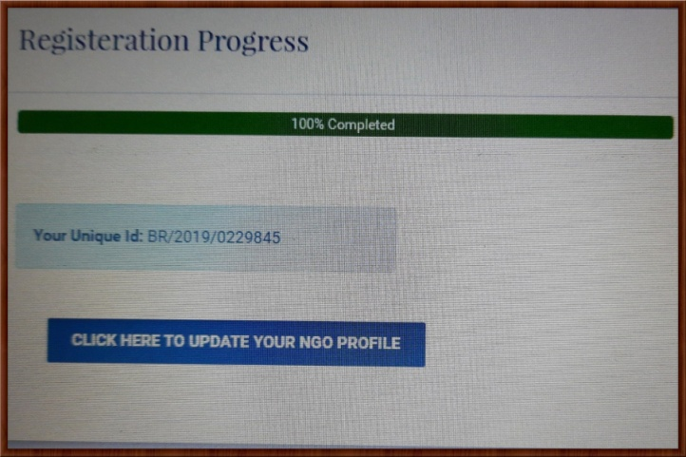
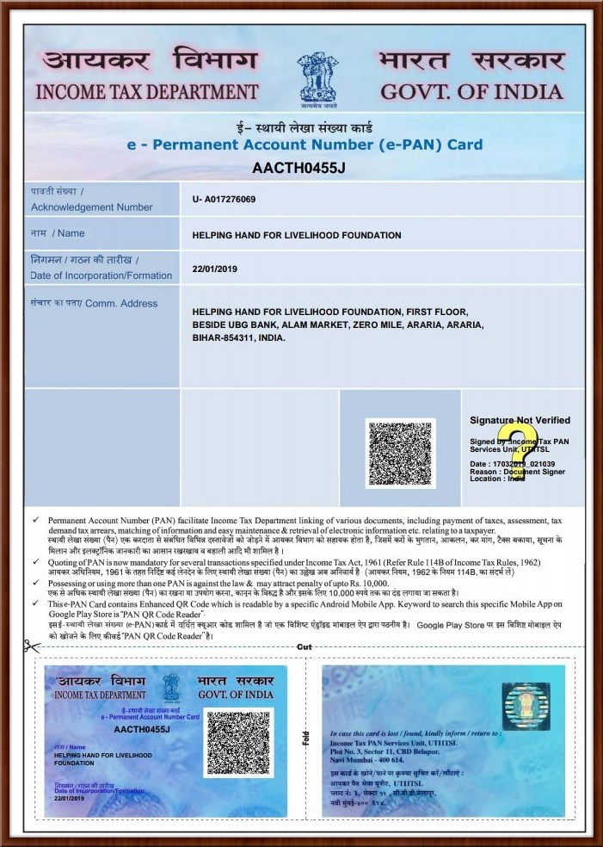
Legalities!

Slide 6
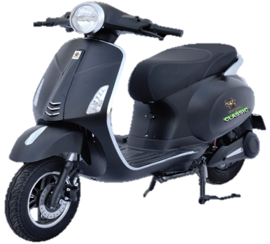
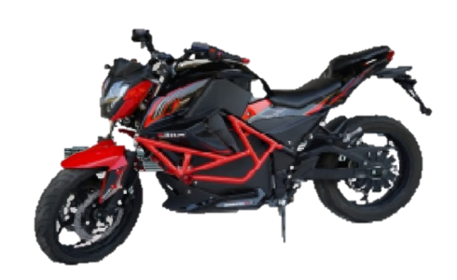
How Do You Get Started?
To Get
MEMBERSHIP
With
SS INNOVEGIC EDGE PVT LTD
A marketing & advertisment of
atomy Global ev
You Have to Pay Rs. 4999/-

Slide 7
Member’s Benefits
Any Member Become a Business Owner
Cash Back & B.D.F Up to 11 th Level
Regular Bonus 300/- to 3000/- Daily
Attractive rewards on Rank Achievement
Avail Atomy Global E.V Showroom
Retirement

Slide 8
Map of General Income
First Regular Bonus
1 : 2 = Rs. 300/- OR 2 : 1 Rs. 300/-
After First Bonus 1 : 1 = Rs. 300/- Unlimited Depth
2 Direct Sponsor is Compulsory
Daily Caping :- 10 Pairs
Daily CLOSING WEEKLY PAYOUT
Daily Income : 10 X 300 = 3000/-
Monthly Income : 30 X 3000 = Rs.90,000/-
Deduction on all income : TDS-5%, Admin Charge- 5%

Slide 9
Attractive Cash Back & Business Development Fund &
Rank Matching Bonus
Level | Team A | Team B | Cash Back/ BDF | Rank M Bonus | Rank
1 | 4 Member | 4 Member | 5000/- CB |  | Sales Executive
2 | 12 Member New | 12 Member New | 10,000/- Hold | 500/- | Jr.Sales Executive
3 | 2 Jr.Sales Executive | 2 Jr. Sales Executive | 15000/- DP EV | 1000/- | Sr.Sales Executive
4 | 2 Sr.Sales Executive | 2 Sr.Sales Executive | 25000/- | 2000/- | Sales Manager
5 | 2 Sales Manager | 2 Sales Manager | 50,000/- | 4000/- | Jr.Sales Manager
6 | 2 Jr.Sales Manager | 2 Jr.Sales Manager | 1,00,000/- | 8000/- | Sr.Sales Mnager
7 | 2 Sr.Sales Manager | 2 Sr.Sales Manager | 2,00,000/- AG1 EV Bike | 10,000/- | Area Sales Manager
8 | 2 Area Sales Manager | 2 Area Sales Manager | 5,00,000/- 4,00,000/- Hold | 12,000/- | Jr.Area Sales Manager
9 | 2 Jr.Area Sales Manager | 2 Jr.Area Sales Manager | 10,00,000/- 9,00,000/- Hold | 15,000/- | Sr.Area Sales Manager
10 | 2 Sr.Area Sales Manager | 2 Sr.Area Sales Manager | 22,00,000/- Dealer Ship of EV | 20,000/- | Regional Sales Manager
11 | 2 Regional Sales Manager | 2 Regional Sales Manager | 35,00,000/- Fortuner | 25,000/- | Zonal Sales Manager Get Reierment

Slide 10
Attractive Rewards
S.N | Designation | Gift | Value
1 | Sales Executive | Joining Kit | ID Card, Folder, Pen
2 | Jr.Sales Executive | Wrist Watch | Worth Rs.2000/-
3 | Sr.Sales Executive | Air Cooler | Worth Rs.2500/-
4 | Sales Manager | Mixer | Worth Rs.3500/-
5 | Jr.Sales Manager | Mobile | Worth Rs.5000/-
6 | Sr.Sales Manager | Mobile | Worth Rs.10,000/-
7 | Area Sales Manager | LED TV | Worth Rs.15000/-
8 | Jr.Area Sales Manager | Lap Top | Worth Rs.20000/-
9 | Zonal Sales Manager | Retirement | 15 Lac

Slide 11
No Body can Afford to miss it !!
Believe it !
Because everyone in this World
as always looking for
New & Unique Ideas which improves their Life Style & fulfill their Dreams

Slide 12
HEAD OFFICE
Mangalpuri, Palam
New Delhi-110045
7366881924
10.30 am to 5.00 pm
www.innovegic.co
info@innovegic.co
“The poor, the unsuccessful, the unhappy, the unhealthy are the ones who use the word "tomorrow" the most. Smart people don’t work for money, they just do things which other people delay doing”
In Business
“Timing Is Everything”
-- Robert Kiyosaki

Slide 13
Presented by A.Hussain & D.K Bakhshi
Mob:8581910022/9123466641

